Slide 1
WA2 –Front-End: CSS
COMP 256 – Dickinson College
Prof. Braught
Spring 2023

Slide 2


Typical Elements of a Web Application
http
https
Front
End
Web APIs
Back
End
Image from: https://rubygarage.org/blog/technology-stack-for-web-development

Slide 3




Fundamental Front-End Technologies
HTML – Hypertext Markup Language
Specifies structure and content
CSS – Cascading Style Sheets
Defines presentation and style
JavaScript
Provides action and Interactivity
Images from: openclipart.org
Notes:
Last time we talked about HTML.
Today we will discuss CSS
- recall that if HTML is the blue print for the house
- the structure and shape and content
- Then CSS is the way it is decorated
- wall colors, flooring choices, curtains, fabric on the furniture, frames on the art etc.
CSS provides an abstraction by
- separating the page content from its presentation (i.e. its style).
- HTML will mark content as a particular type of thing
- header, image, button, emphasized, strong etc…
- CSS is then used to specify what those things look like.
- This allows the way that a page is displayed to be changed without changing its content.
- E.g. the color scheme or fonts used on an entire site can be changed very easily by changing the style.
- Without CSS a developer would have to go through all of the pages in the entire site and update them one by one.
- This is sort of like using constants instead of having “magic numbers” hard coded into the program.
- Then if the value changes, you just change the constant in one place and don’t have to find it everywhere that it is used.

Slide 4

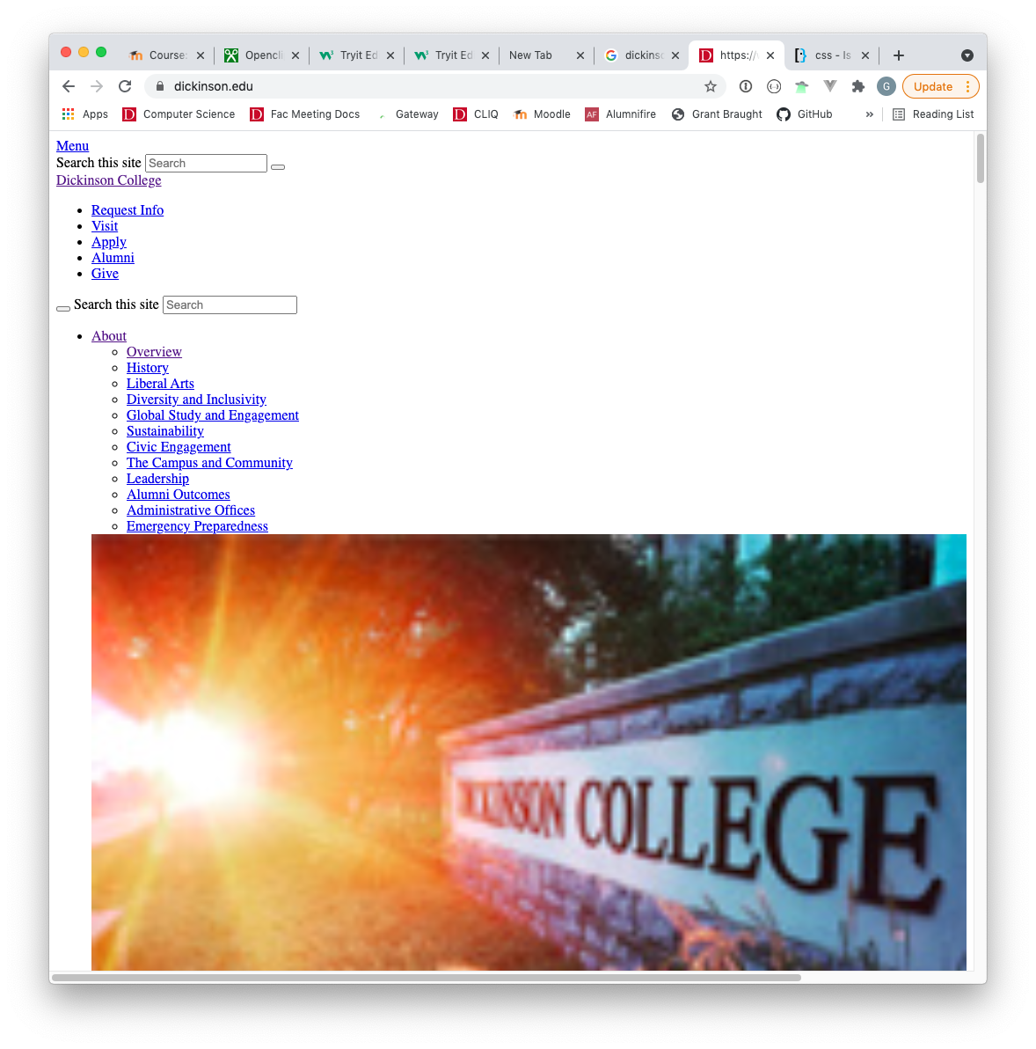
The Default Style Sheet
Notes:
Every browser has a set of default styles (a.k.a. a default style sheet).
This default style sheet specifies how that browser will display plain HTML content:
- This is what so far has made:
- h1 elements appear large bold
- em elements appear in italics
- strong elements appear boldface
- links appear underlined
- etc
The default style sheet specifies a set of styles that is to be applied to those elements.
- each browser might display them somewhat differently.
Very nice looking web sites:
- Like the Dickinson Home page replace the default style sheet with a custom one.
- This changes how the different elements are displayed.
We can see this in the browser:
- Load the Dickinson Home Page.
- Open the developer tools (varies by browser)
- Under View menu in Chrome
- Under Tools menu in Firefox
- Click the ”Elements” tab in the dev tools
- We can see the <title> element that we know about.
- If we edit that element the title in the tab will change.
- Note: this is just changing the value of that element in the DOM in our browser.
- It is not changing the actual Dickinson site.
- Similarly, if we delete the <title> then the title of the tab goes aways too.
- the element was removed from the DOM
- The title becomes the URL.
- We can also see the <head> element
- As we’ll see the <head> element is also where we define the styles that are applied to the page.
- If we remove the head element (like we did with the title)
- Then the page will be rendered using the default style sheet
- It is not very pretty…
- But everything is still there (and actually some other stuff that is hidden by the styles).
- Can put the styles back in with an undo.
- Toggling back and forth,
- you can see that the ”Menu” contains
- ABOUT, ACADEMICS, LIFE AT DICKINSON, ADMISSIONS, TUITION & AID and ATHLETICS
- if you scroll down the page without the style you’ll see those sections.
- You also see more content under each of those sections.
- With the styling this content appears in the drop downs
- E.g. clicking on ABOUT shows the Overview, History, Liberal Arts… etc and the two pictures.
- In the <body> element there is the attribute ”class”
- the ”sub-open” style indicates that the “MENU” should be displayed.
- Removing that hides the menu.
- Interestingly, there is some JS that puts that style back in if you scroll down and back up.
- The other two classes here do not seems to have much effect on this page.

Slide 5
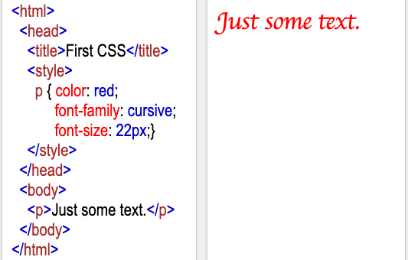

The <style> Element & CSS Rules
The <style> element contains CSS Rules that specify how page elements are to be rendered.
These CSS Rules override the browser’s default style sheet
Editor at: https://www.w3schools.com/html/tryit.asp?filename=tryhtml_basic
Notes:
Notice Here that the paragraph <p> element is no longer rendered in plain text like the p element we saw before.
Before the browser was applying the default style sheet
Here we have modified the style of the p element
- We’ll get into the details of how this works in a minute.
- For now just notice that a <style> element has been added to the head.
- That style element has some content that if we look at it will make some sense…
- p – indicates the type of element that we want to style.
- color, font-family, size – indicate how we want different attributes of that element to appear.
Do a little live coding here:
- If we change the rule, it will change the way the p element is rendered
- change the color to blue
- or the size to 8
- Notice this applies to all of the p elements in the page.
- add another p element.
- Also notice that it does not apply to any other elements.
- add an <h2> element.
- Here the default style is still used because we have not changed it.
By Using CSS rules we will be able to set the style of any page element
It is possible to control the style of elements in an amazing variety of ways
- our job here is not to become CSS experts and know all of these ways.
- instead we want to understand
- what the role of CSS is
- a little about the basics of how it does what it does
- and how it relates to other front end technologies (HTML, JS and Frameworks and Libraries)
It would be remiss if not to mention that there are also a wide variety of ways to specifying styles
- it can be done in the head like shown here (and how we will do it for this class)
- it can be done in using attributes in the individual HTML tags of the elements being styled
- it can be done in a separate file containing just the CSS styles.
- from practical point of view it matters which way you do it.
- from a conceptual point of view it is irrelevant which way you do it
- so we will do it using a style element in the head of the page in this class because it is relatively easy.
Code to Paste:
<html>
<head>
<title>First CSS</title>
<style>
p { color: red;
font-family: cursive;
font-size: 22px; }
</style>
</head>
<body>
<p>Just some text.</p>
</body>
</html>

Slide 6
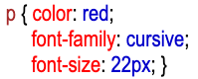
The Syntax of a CSS Rule
Declaration
Block
Declaration
Selector
Property
Value
Notes:
Let’s pick apart the CSS rule that was contained in the <style> block on the prior slide.
This will give us some vocabulary to use to talk about CSS rules and will help us understand how they work.
Every CSS Rule has the same basic parts:
- selector
- The selector determines the elements in the page to which the style will be applied.
- Here the selector says to apply the style to all of the <p> elements.
- declaration block
- The declaration block is just what appears between the { }
- It is filled with declarations.
- declaration
- There are 3 declarations in the declaration block above.
- color: red
- font-family: cursive
- font-size: 22px
- there can be as many declarations as desired in the declaration block
- each is separated by a ;
- here they are also on separate lines
- That is not necessary but it makes the code easier to read and is considered good style.
- Each declaration is divided into two parts:
- property
- The property name indicates the thing that is to be styled
- The color, the font-family, the font-size, etc…
- value
- The value indicates how the property is to be set (styled)
- The property and value are separated by a colon.
There are lots and lots of properties (300+) that can be set
- What those properties are and the values that can be used depends on the type of element being styled.

Slide 7
CSS Selectors
CSS Selectors determine the HTML elements to which a CSS rule applies.
There are three main types of CSS selectors
Element Selectors
Class Selectors
ID Selectors
Notes:
The Selector part of a CSS Rule determines which HTML elements the rule applies to.
- In the prior example we saw a rule that applied to all of the <p> elements.
- that is called an element selector.
It is also possible to apply rules more selectively.
- Maybe we only want to apply a style to some paragraphs, or to a few of the elements of a list but not all of them.
- Class selectors and ID selectors allow us to apply CSS rules more selectively than element selectors.
We’ll look at each of these in more detail on the next slides.

Slide 8
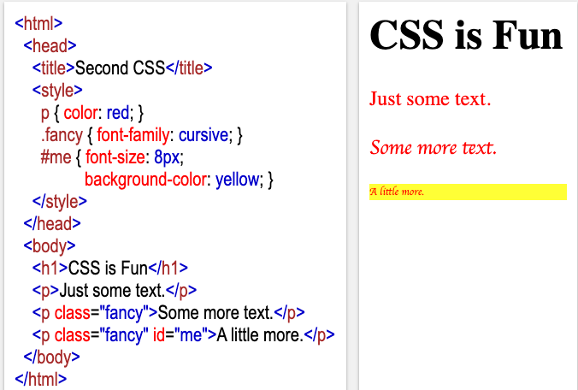
Element Selectors
Element Selector: Style applies to all elements of the specified type.
Notes:
A rule with an element selector will apply to all elements of that type.
- To write a rule with an element selector the name of the tag is used as the selector.
- For example here, p is used as the selector.
- This means that all elements of type p will be styled using this rule.
- In the rendered HTML on the right we can see that all three of the paragraphs have red text.
If I wanted to style the Header h1
- Then I would write a rule with h1 as the selector.
Any tag can be used as an Element Selector.
- But the style applies to all elements of that type.
- That can be a little restrictive.

Slide 9
Class Selectors
Class Selector: Style applies to all elements with a matching class attribute.
Notes:
Class selectors allow us to apply a rule to specific elements.
- Here the rule “fancy” is applied to the second and third paragraph elements, but not to the first one.
- In the rendered HTML on the right we can see that only the second and third paragraphs have cursive text.
To declare a rule with a class selector:
- use a . and whatever name you want to give to that rule.
- here the selector for the rule is .fancy
To apply a rule with a class selector to an element:
- add a class attribute to the tag
- set the value of the class attribute to be the name of the selector for the rule (without the .)
- Here the second and third paragraph elements have:
- class=“fancy”
- This says that the rule with the selector .fancy should be applied to them.
- Which is what we see in the rendered HTML on the right.
- The second and third paragraphs are rendered in cursive font.

Slide 10
ID Selectors
ID Selector: Style applies to the one element with the matching id attribute.
Notes:
ID Selectors are the most specific.
- They are intended to apply to only a single element.
- Here the rule “me” is applied to just the third paragraph element.
- We can see in the rendered HTML that it has a yellow background and appears in a smaller font than the other paragraphs.
To declare a rule with an ID selector:
- Start with a #
- Use whatever ID name that you like.
To apply a rule with an ID selector to an element:
- add an attribute named id to the element
- set the value of the id attribute to the name of the selector for the rule (without the #)
Here the third paragraph has:
- id=”me”
- This says that the rule with the ID selector “me” should be applied to that element.
- That is what we see in the Rendered HTML on the right.
- The third paragraph appears with a yellow background.
Note that an ID selector should apply to exactly one element.
- While most browsers do not enforce this it is considered poor style to use an ID selector on multiple elements.
- Typically, ID selectors are rarely used because of this specificity.
- Class selectors are by far the most commonly used selectors in practice.

Slide 11
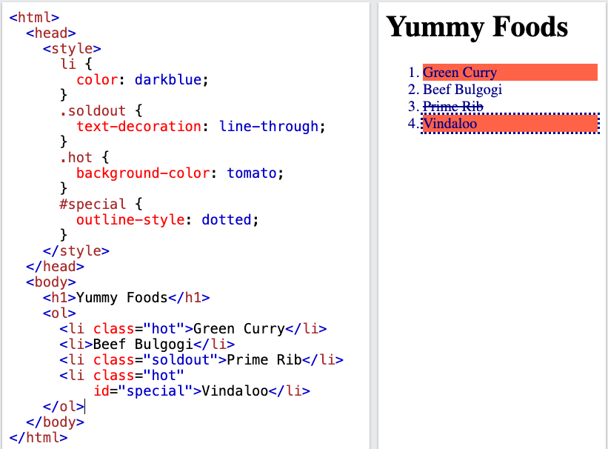

What CSS selectors would you need use to produce the rendered HTML?
Notes:
What would go in the green highlighted areas?

Slide 12
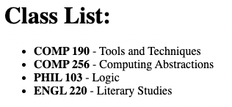
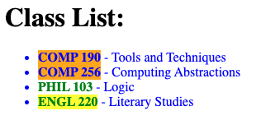
<html>
<head>
<title>Class Ex CSS</title>
<style>
</style>
</head>
<body>
<h1>Class List:</h1>
<ul>
<li><strong>COMP 190</strong> - Tools and Techniques
<li><strong>COMP 256</strong> - Computing Abstractions
<li><strong>PHIL 103</strong> - Logic
<li><strong>ENGL 220</strong> - Literary Studies
</ul>
</body>
</html>
Use the HTML/CSS editor to add styles to the given HTML to produce the rendered page.
Editor at: https://www.w3schools.com/html/tryit.asp?filename=tryhtml_basic

Slide 13






CSS Libraries
CSS Libraries and Frameworks provide abstractions built on HTML/CSS/JS that make it easier to build rich / responsive web applications.
Notes:
Most people do not write much CSS.
Typically, if you are a web developer you will use one or more CSS Libraries
- or Frameworks
These are just collections of HTML/CSS/JS
- provide abstractions that you can incorporate into your sites.
You’ll see just a little bit of one in the activities.
Tailwind
Bootstrap
Materialize
Bulma
Material design lite
Pure CSS
Just to name a few of the top ones.

Slide 14


Acknowledgments
Slide Template From:
https://creativecommons.org/licenses/by/4.0/
Slide Content Licensed as:
Creative Commons Attribution-NonCommercial-ShareAlike 4.0 International License.
Notes:
Note: Individual images may be covered by their own licensing agreements and were incorporated here under fair use. Their use in this slide deck does not change or alter their licensing.

